Slide 1
Northeast Chapter of Land Surveying Summer Meeting
Brown County Zoning update on new FEMA maps
Matt Heyroth – Zoning Administrator

Slide 2
Some questions I will try and answer:
Where in Brown County did the new FEMA map panels update?
What are the new flood zones and what do they mean?
Is this part of the Great Lakes Coastal Flood Study project?
Where can flood study information be downloaded?
How to properly interpolate between transect lines?
Any important dates when fill is considered fill?
Any major ordinance changes due to the new flood maps?

Slide 3
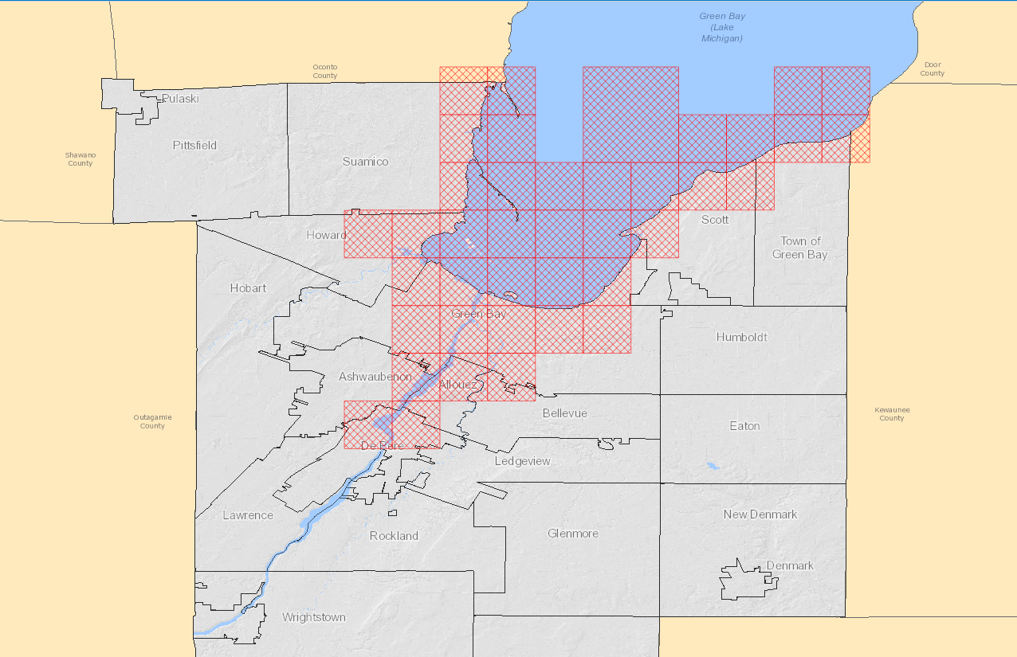
Where in Brown County were the new FEMA map panels updated?

Slide 4
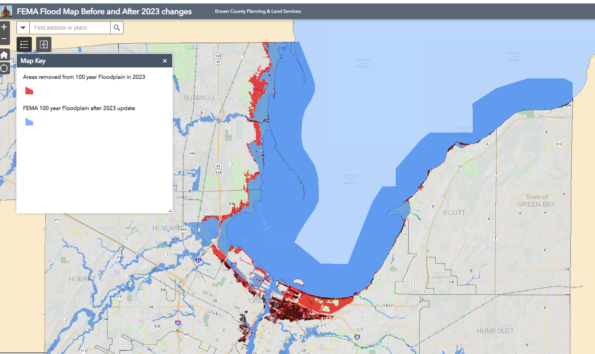

Slide 5
Share PowerPoint with group and you can click on link below
which hopefully will bring you right to the location for viewing
https://browncounty.maps.arcgis.com/apps/webappviewer/index.html?id=29a9b59d678d45468b538692d2752dd8

Slide 6
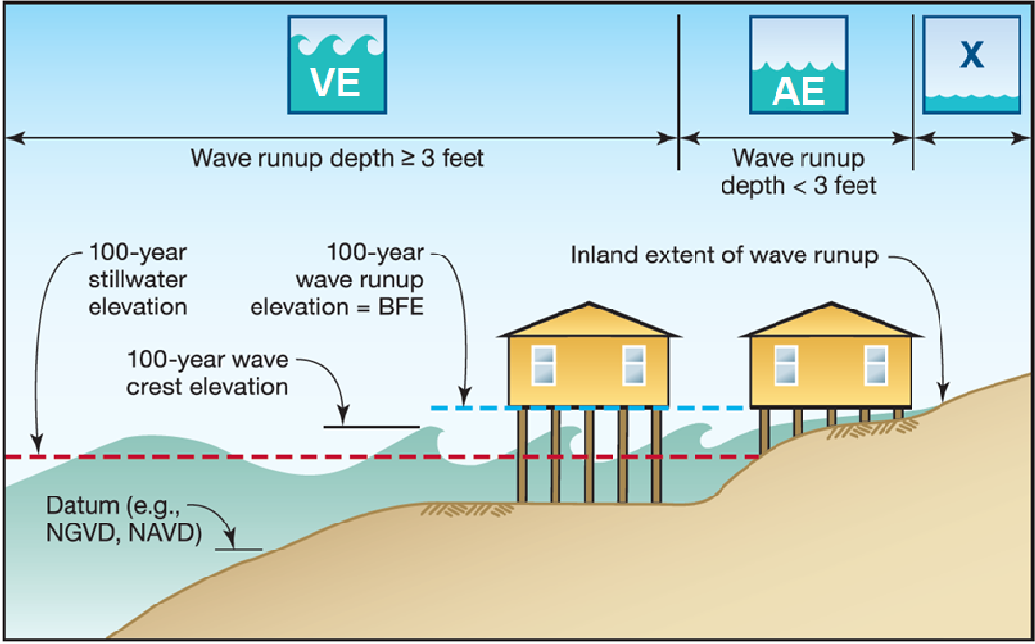
What are the new flood zones and what do they mean? Special Flood Hazard Areas (SFHAs)
Zone VE
Coastal high-hazard zone, where wave action and/or high-velocity water can cause structural damage during the 1-percent-annual-chance flood
Wave heights or wave runup >= 3 feet
Subdivided into elevation zones, and BFEs are assigned
Zone AE
Applied in areas subject to lower wave energy or inundation by the 1-percent- annual-chance flood
Wave heights or wave runup < 3 feet
Subdivided into elevation zones, and BFEs are assigned
Zone AO
Applied in areas of sheet-flow and shallow flooding
Given an associated depth instead of a BFE
Zone AH
Applied in areas of ponding
Assigned a BFE

Slide 7
THIS SLIDE INDICATES SOME FEMA NATIONAL STANDARDS KEEP IN MIND THAT THERE ARE MORE RESTICTIVE LOCAL STANDARDS!!
E

Slide 9
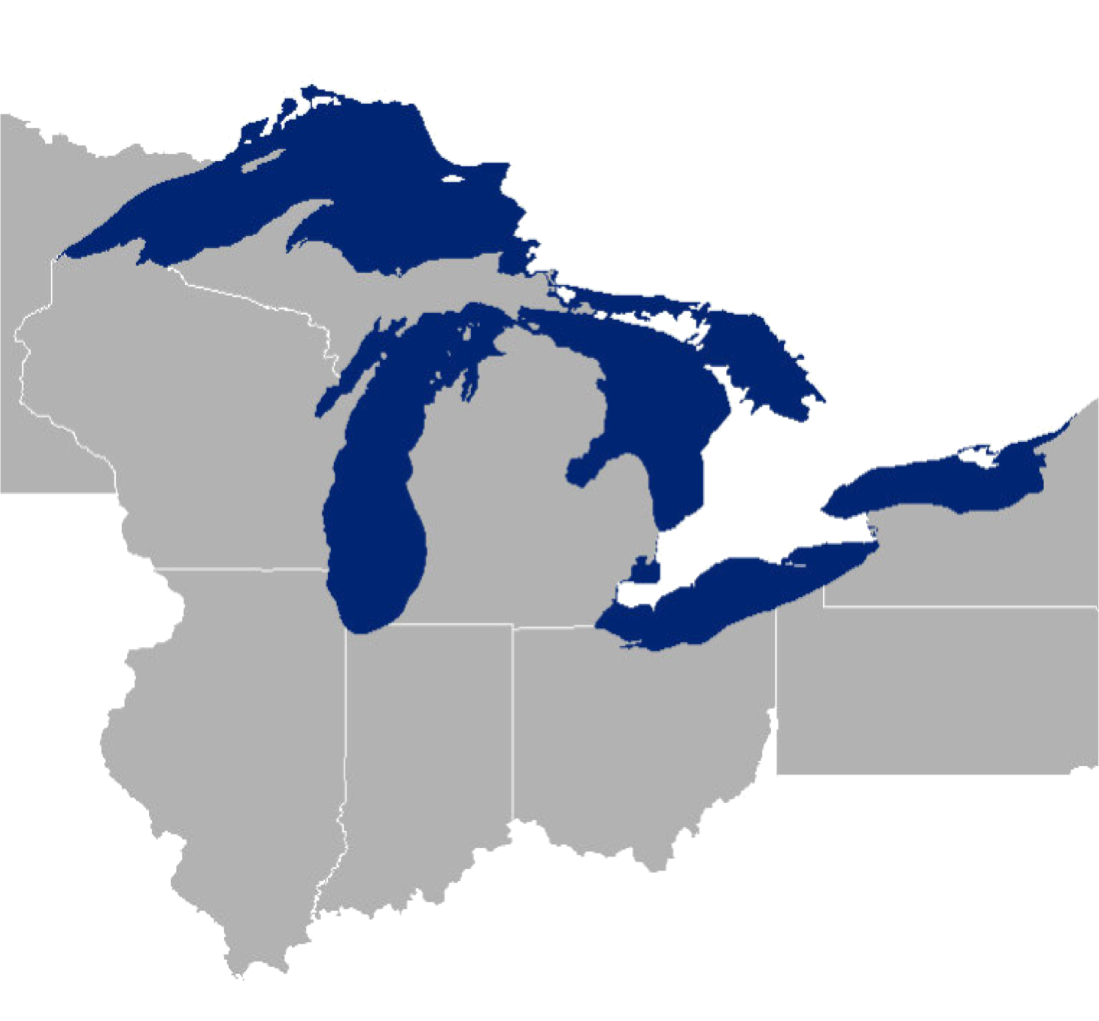
Is this part of the Great Lakes Coastal Flood study project and why is FEMA Updating Your Flood Maps?
The Great Lakes Coastal Flood Study provides updated flood risk information for areas around each of the Great Lakes using uniform methodology, updated terrain data, and modern wave modeling techniques.
Many factors contribute to flood map revisions:
▸ Population growth & increased development
▸ Movement in rivers & shorelines
▸ Changing technology and improved modeling techniques and data

Slide 10
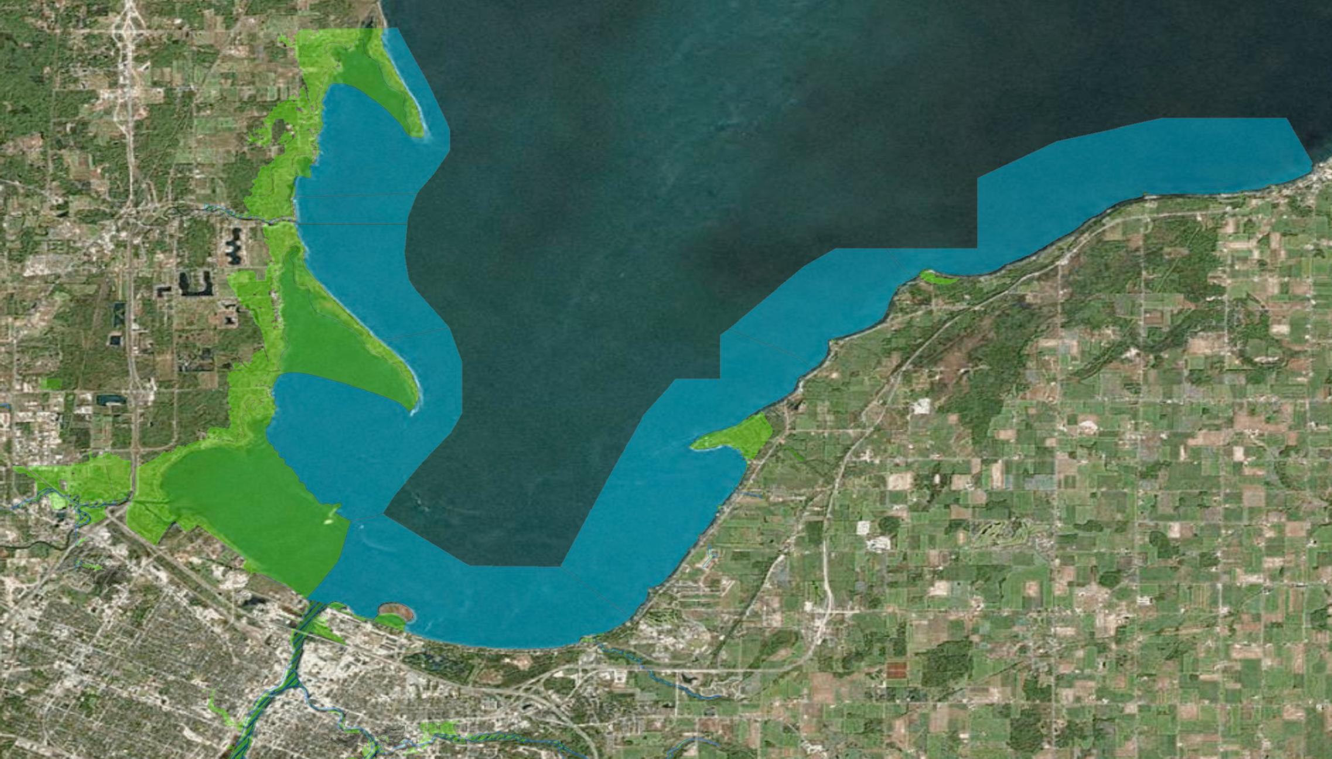
The Great Lakes Coastal Flood Study in Brown County
Coastal Flood Hazard Analysis:
41 miles of coastline
35 FIRM panels (2 NP)
8 communities
22 coastal transects
Transects placed at representative shoreline reaches based on:
Topography
Exposure
Shoreline material
Upland development
«¬01
#
#
#
#
#
#
#
#
#
«¬02
#
#
#
«¬
«¬
«¬
#
#
22
21
#
03
#
#
«¬
«¬
«¬
18
«¬
20
04
«¬
19
17
«¬
05
«¬
«¬
16
15
#
#
#
«¬
«¬
14
06
«¬
#
13
#
#
«¬
07
«¬
«¬
12
# # #
08
«¬
09
«¬
«¬
11
10
Integration of riverine - coastal Special Flood Hazard Areas
Topography
USACE JALBTCX LiDAR (2013): 1-meter DEM
Wisconsin Department of Natural Resources (2010): 1.5-meter DEM

Slide 11
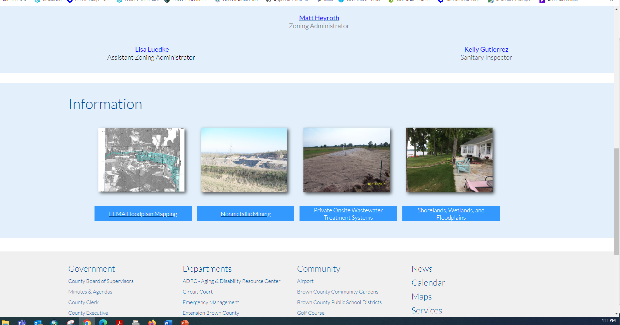
Where can flood study information be downloaded?

Slide 12
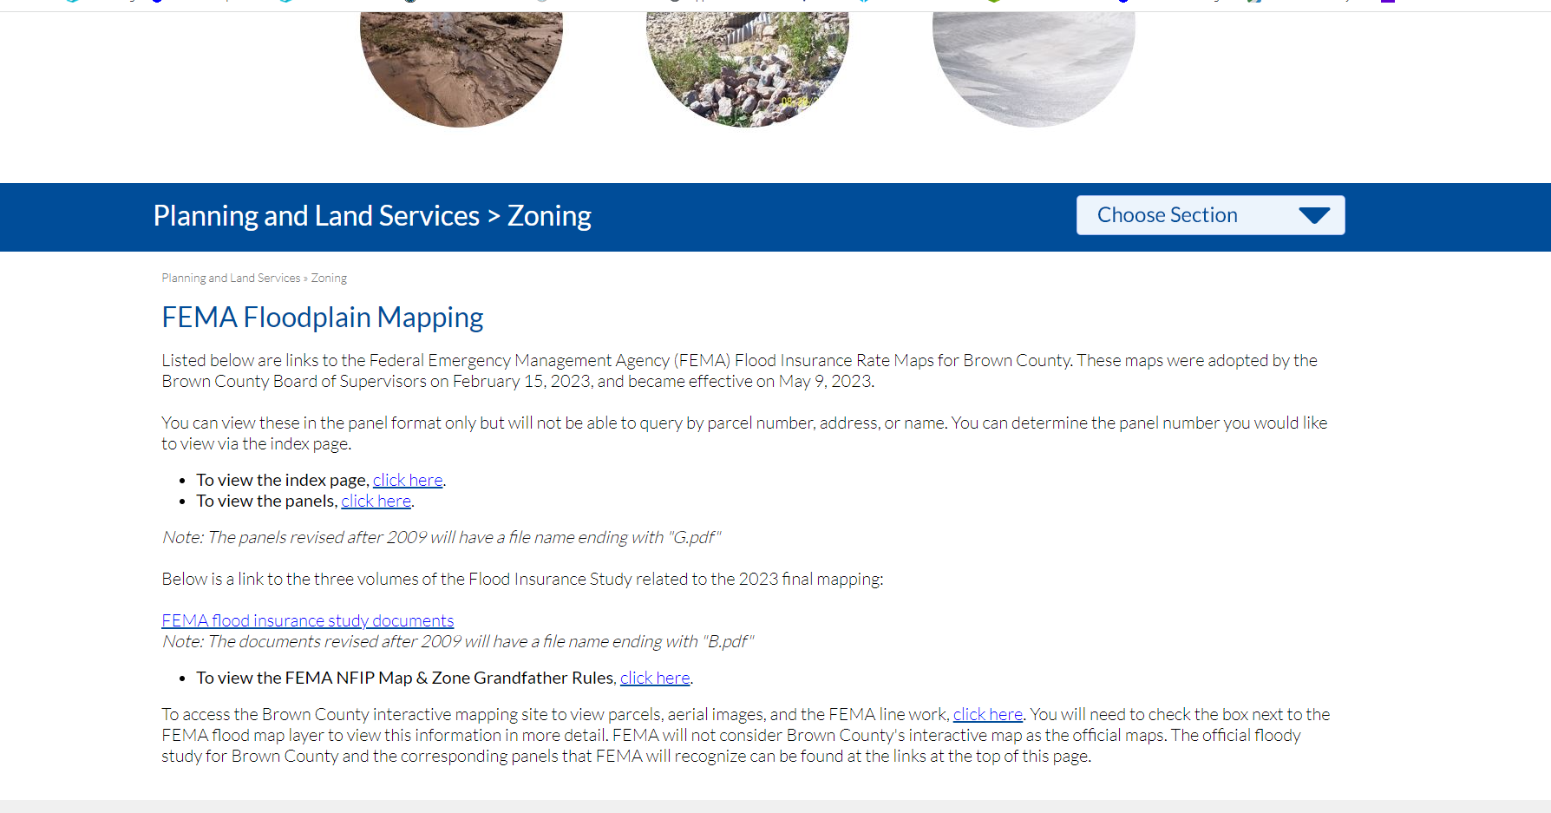

Slide 13
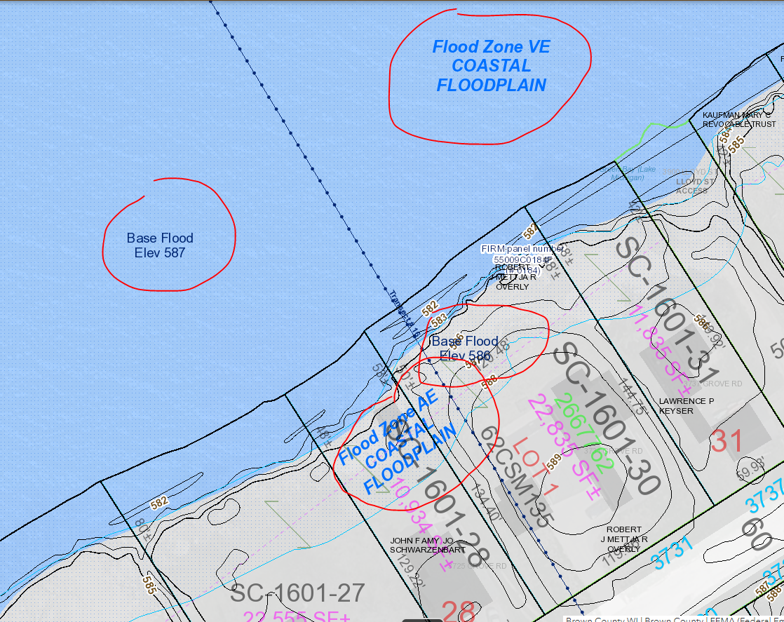
How to properly interpolate between transect lines?

Slide 14
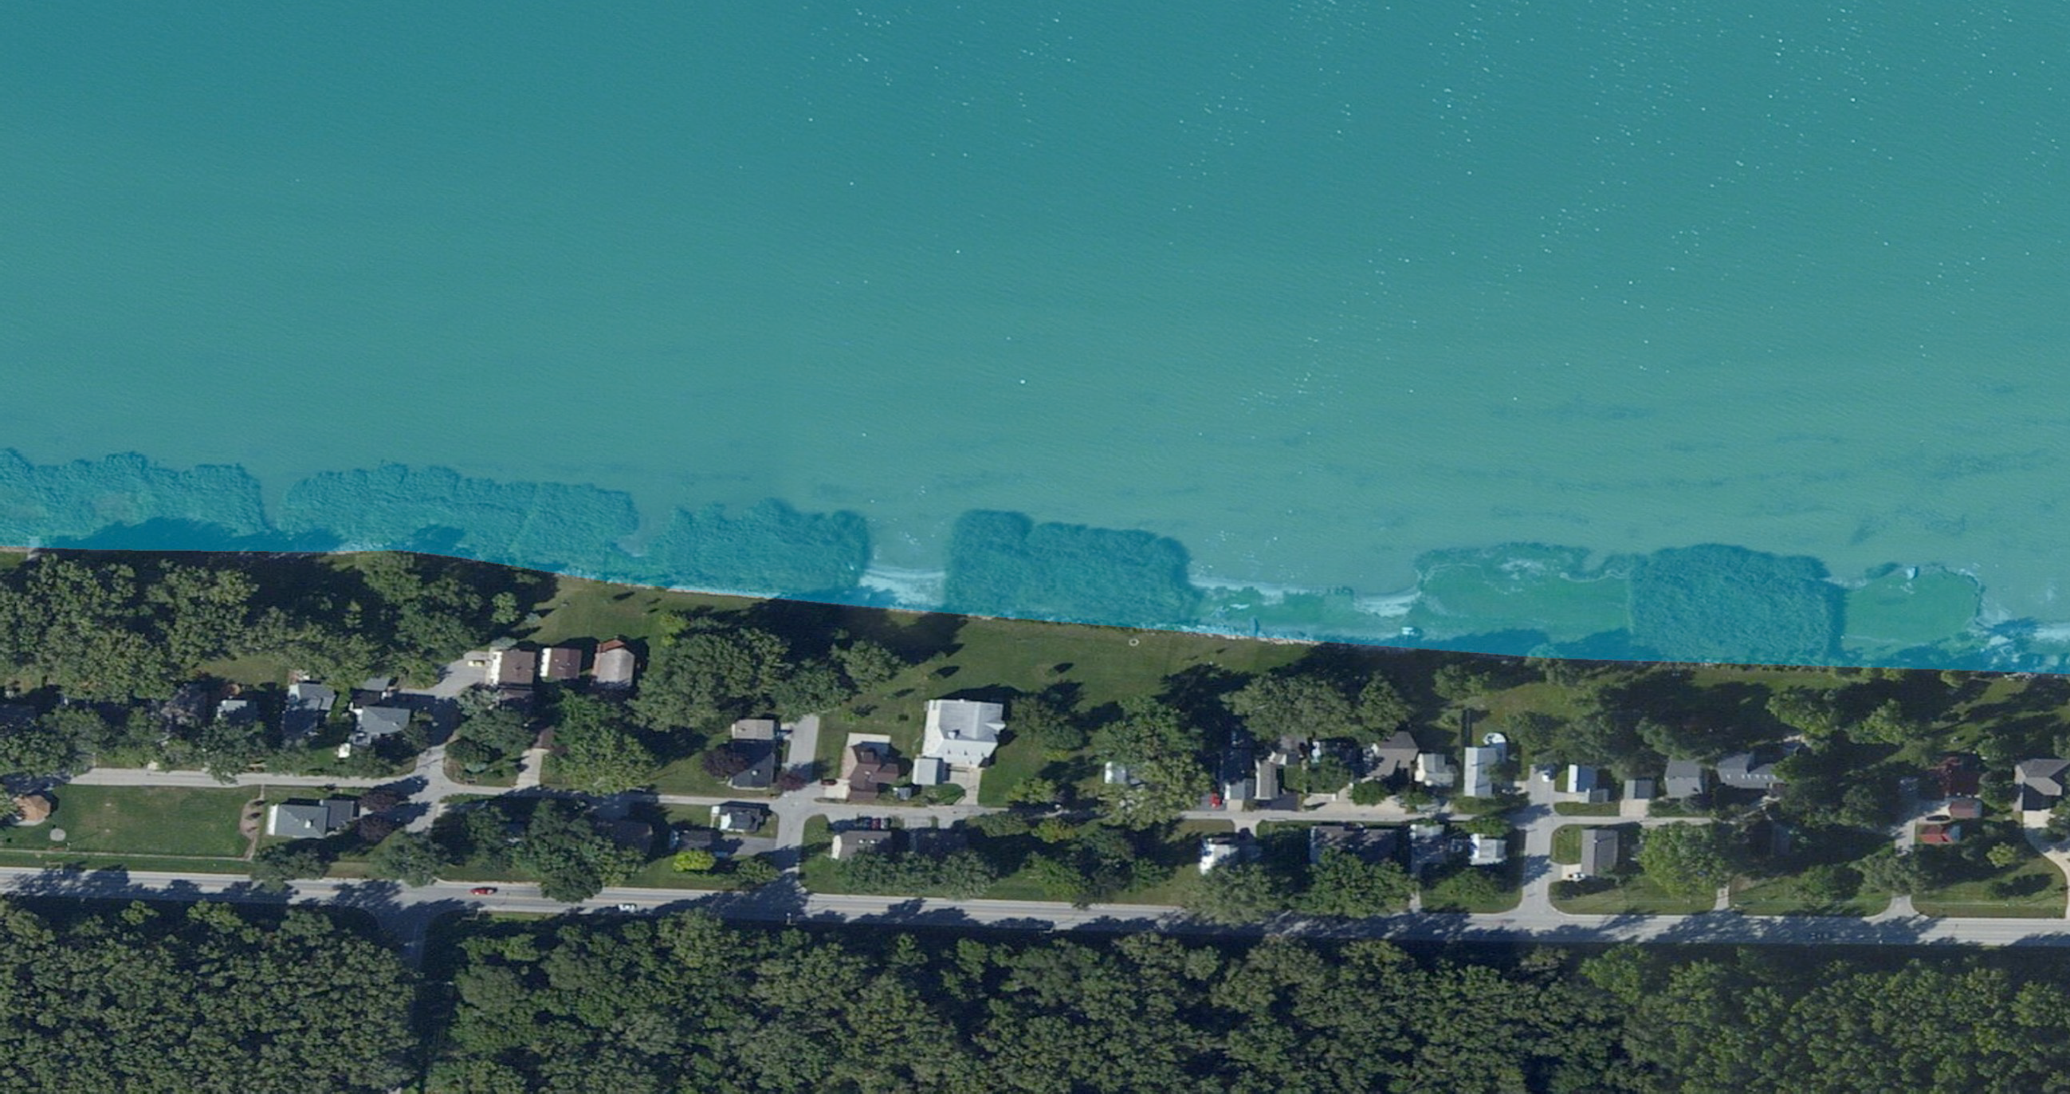
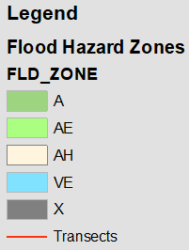
Wave Runup Mapping
Wave runup is very sensitive to shoreline characteristics, especially slope
Single Base Flood Elevation (BFE)
Zone breaks (aka Gutters) perpendicular to the shore divide the BFEs
VE 588
10
Source: Esri, DigitalGlobe, GeoEye, Earthstar Geographics, CNES/Airbus DS, USDA, USGS, AeroGRID, IGN, and the GIS User Community

Slide 15
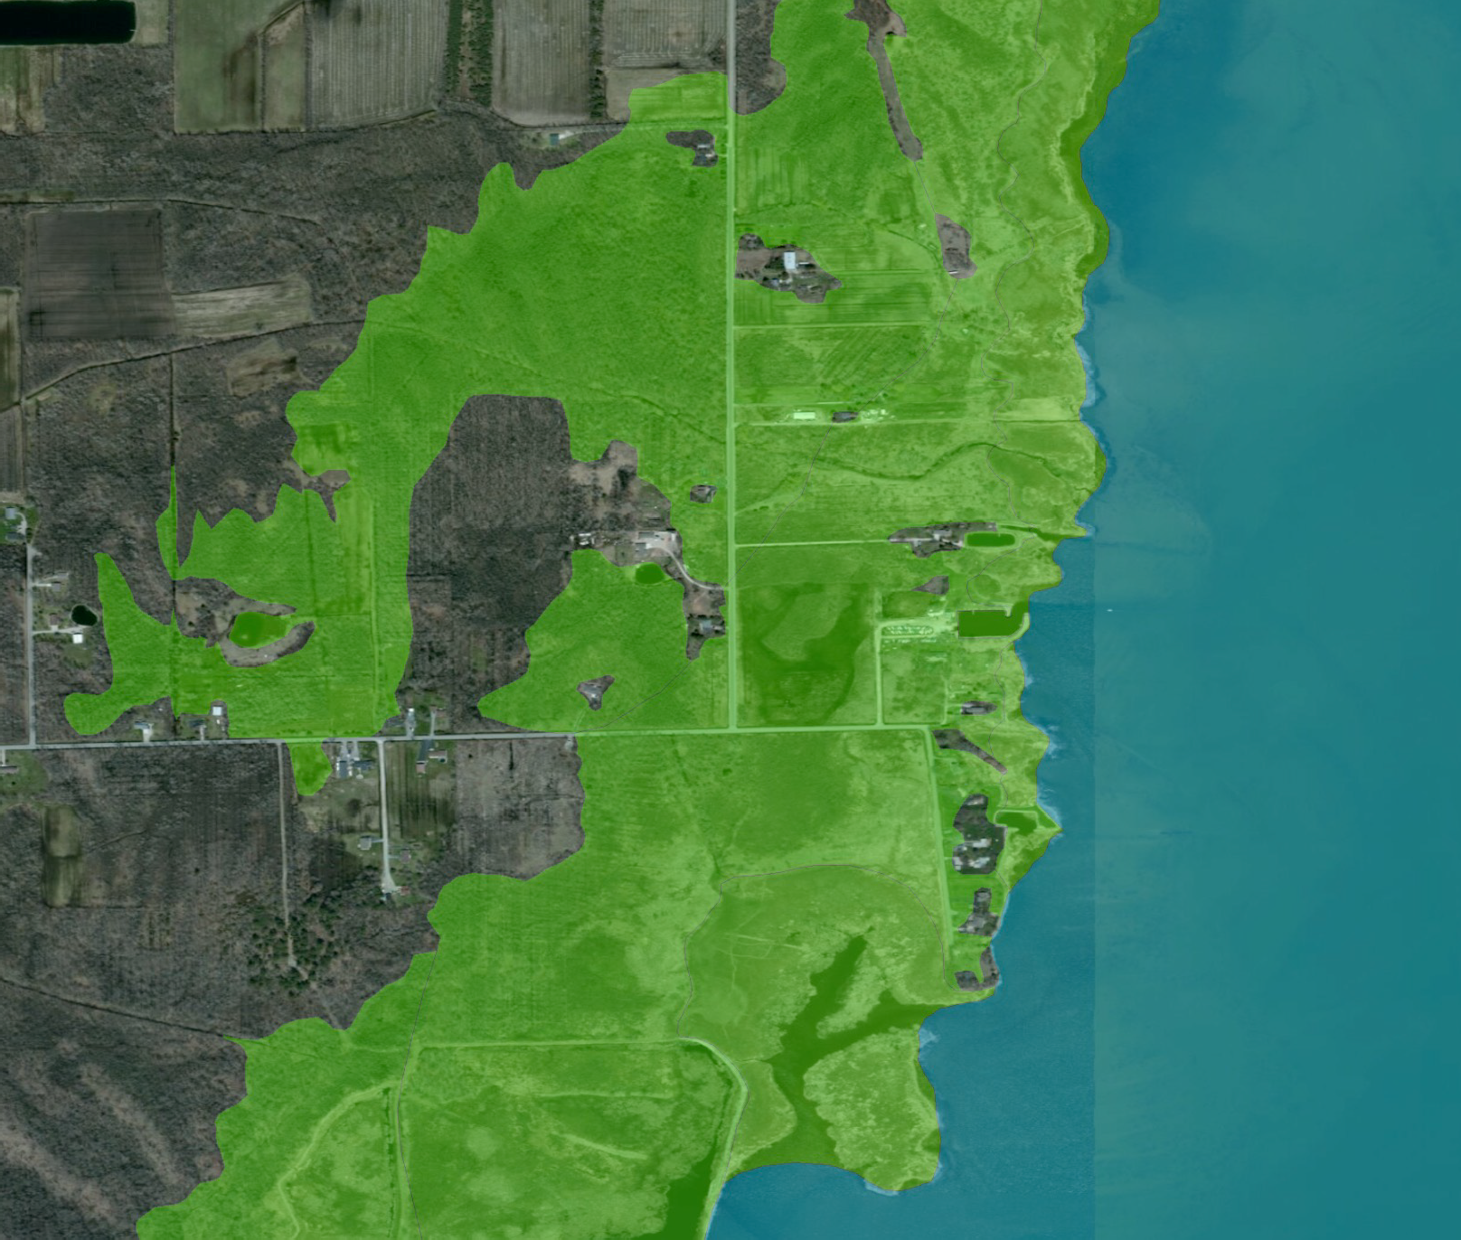
Overland Wave Propagation Mapping
Tiered Base Flood Elevations reflect the overland wave decay or regeneration over inundated inland areas as waves propagate onshore over different terrain
BFEs are defined by wave crest elevation
Zone breaks (aka Gutters) are placed where BFEs change moving onshore and follow land use features or terrain elevations
Landward extent of mapping defined by 1% SWEL
AE 584
AE 586
AE 584
VE 587
AE 585
AE 586
02
AE 586
AE 584
Source: Esri, DigitalGlobe, GeoEye, Earthstar Geographics, CNES/Airbus DS, USDA, USGS, AeroGRID, IGN, and t

Slide 16
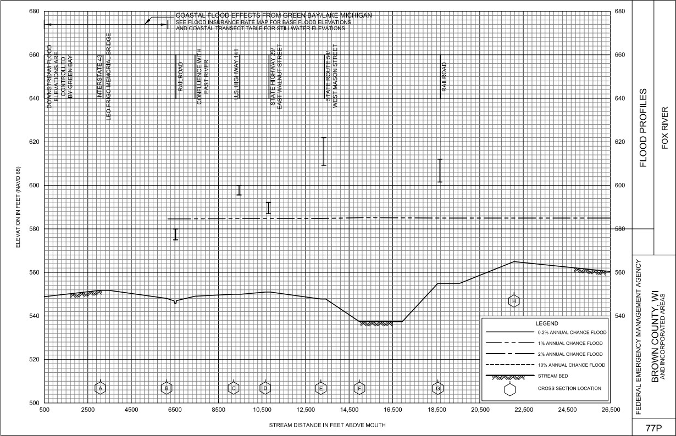
Riverine-Coastal SFHA Integration
Riverine Confluences:
Suamico River
Duck Creek
Fox River
Mahon Creek
Unnamed Tributary

Slide 17
Any important dates for fill placement?
Not that I’m aware of – For the 2009 update 2007 used
We do have ability to compare 2020 contour info. to 2010 and 2000

Slide 18
How has the new maps changed Ordinance?
No more basement exemption but basements if constructed must be AT or HIGHER than the BFE and floodproofed to 2 feet above the BFE
Removal of land from the floodplain entails filling 2 feet above BFE, contiguous to land outside the mapped floodplain, obtaining a LOMR-F and rezoning the area out of the mapped floodplain
Brown County Zoning will NOT sign CAF unless documentation is provided commenting on ESA, compliance with TB 10-01 (compaction standards have been met)
Slab construction requires the slab to be 2 feet above BFE for a habitable structure and accessory structure just needs to be at or above BFE

Slide 19
Effects of New Flood Zones on Flood Insurance
▸ The new FIRM may:
Map a property into the SFHA for the first time
Lender may require them to get an insurance policy
Remove a property from the SFHA
Lender may drop the insurance requirement
Change the flood zone affecting the property
From an A zone to a VE zone (or from Zone AE to Zone AO, etc.)
Rating will not change unless the policy is allowed to lapse or the building is substantially improved
If the new zone results in a less costly premium, the policy can be endorsed to revise the rate to the new zone with a prorated refund for the difference for the remainder of the policy year. Insured needs to ask the AGENT to do this!

Slide 22
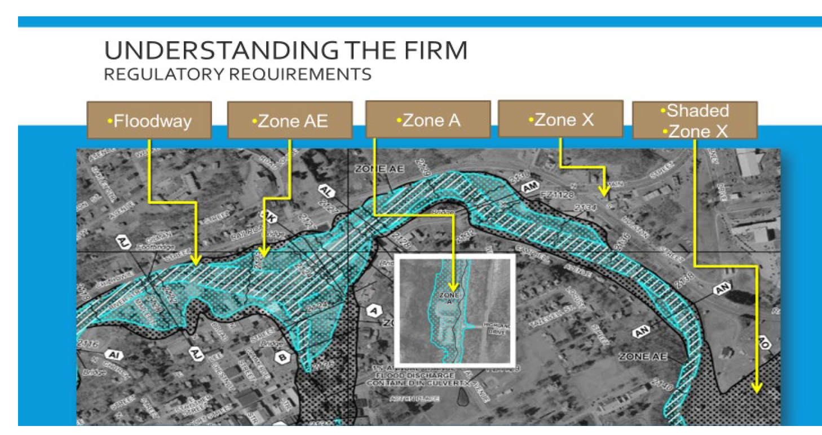

Slide 25
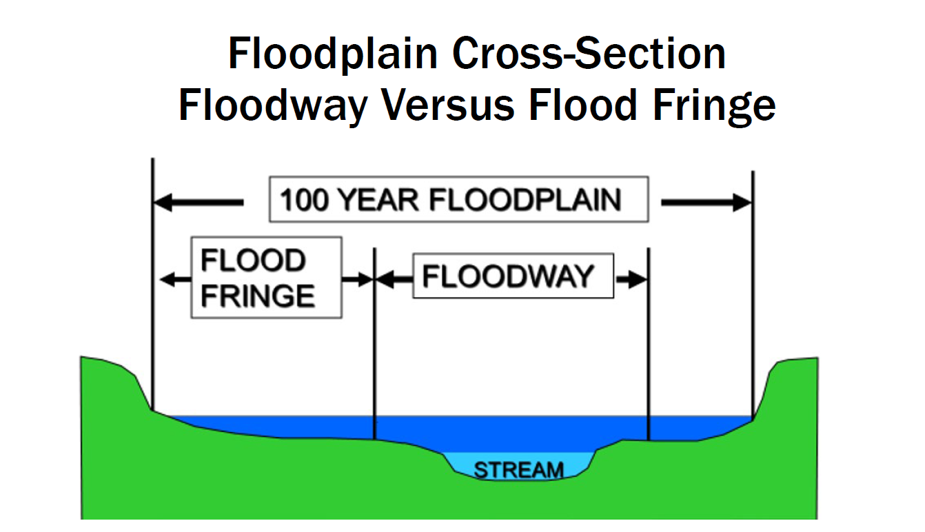

Slide 27
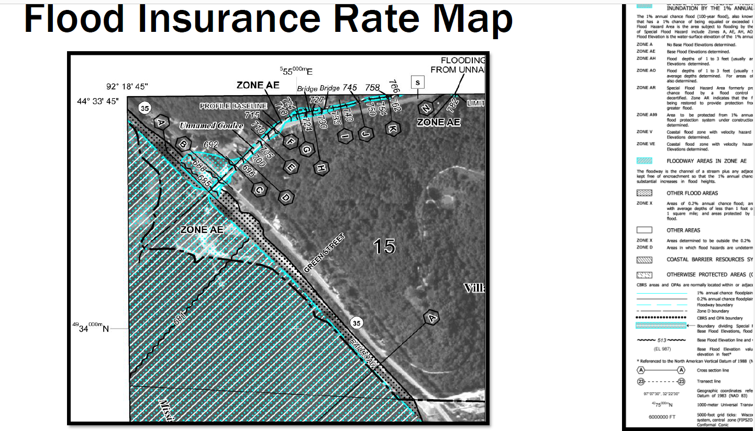

Slide 28
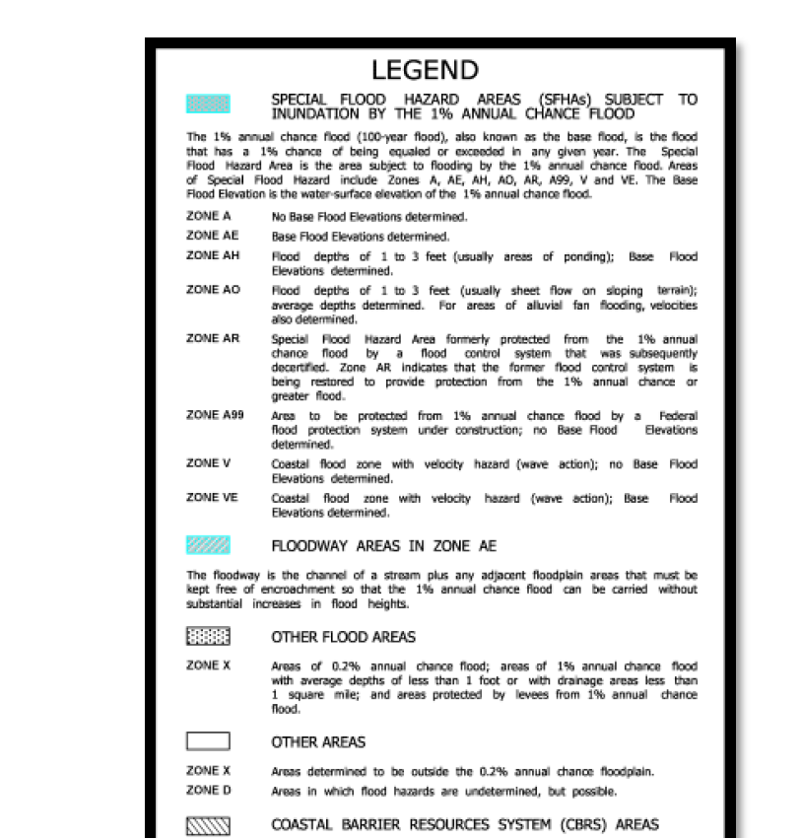

Slide 29
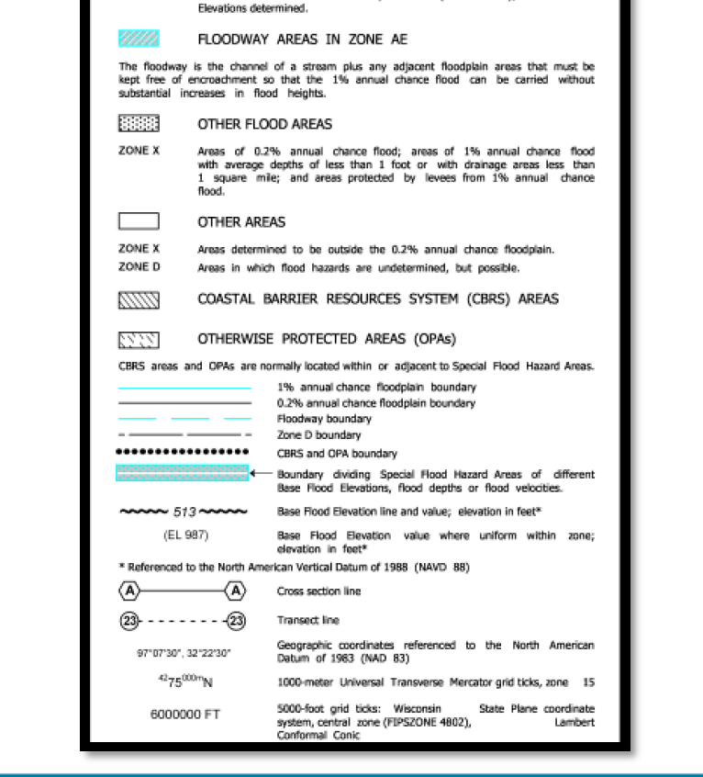

Slide 31
QUESTIONS???
Contacts for Brown County (all unincorporated areas and Villages of Bellevue and Allouez) related floodplain questions:
MATT HEYROTH – (920) 680-7897 matt.heyroth@browncountywi.gov
LISA LUEDKE – (920) 680-7898 lisa.Luedke@browncountywi.gov
Other helpful contacts:
Insurance Information James Sink –Regional Flood Insurance Specialist james.sink@fema.dhs.gov
FEMA Frank Shockey –Senior Floodplain Management Specialist frank.shockey@fema.dhs.gov
DNR – Ryan Pichler – Ryan.Pichler@wisconsin.gov or mobile (920) 769-6234

