Slide 1
The Ins and Outs of Access Easements
Northeast Chapter of Wisconsin Society of Land Surveyors
May 12, 2023
Attorney Jessica Shrestha
jshrestha@fredlaw.com
608.441.3839

Slide 2
General Outline
How Access Easements are Created
Interpretation of Access Easements
Duty to Repair and s. 710.20
Easement Terms
General Easement Principals
Expiration of Easements under s. 893.33

Slide 3
Two Types of Easements
Appurtenant
Easement “runs with the land”
In Gross
Benefits the holder of the easement personally, as opposed to a particular piece of property.
Dominant and servient estates = benefitted and burdened property.
No “dominant estate.”
Examples: hunting, lake access, utilities
Presumption of assignability unless otherwise stated

Slide 4
How (private) Access Easements are Created
Written Grant or reservation
Plat or CSM
Prescription
Necessity
Implication

Slide 5
Express Easements
Must satisfy statute of frauds (Wis. Stat. § 706.02)
Must identify the parties
Recording is not required, but important for other reasons
Wis. Stat. § 706.08, non-recorded conveyance is not effective against purchasers for value
Reservation in conveyance or granted by separate document
Identify the land (both the benefitted and burdened parcels)
Identify the interest conveyed and the material terms
Signed by all necessary parties
Delivered
Wis. Stat. § 706.09, purchasers for value who lack notice take estates free of adverse or inconsistent claims.

Slide 6
Express Easements (cont.)
Negative Easement – Allows the holder to prevent the use of the
property for some stated purpose, or to remove some feature
Easement by Reservation – When the owner of land conveys the
property to another but reserves certain rights and privileges for themselves.
Positive or Affirmative Easement - Gives the easement holder the
right to use the land of another, such as a road or driveway.

Slide 7
Private Easement By Plat or
Certified Survey Map
Wis. Stat. § 236.34(1m)(e), easements may be created in favor of private parties by notation on the map.
The words "reserve", "the use of" and "privileges" in a plat is indicative of a conveyance of easement rights, not property in fee simple. Kapinus v. Nartowicz, 2022 WI APP 39, ¶27, 404 Wisc. 2d 19, 978 N.W.2d 216.
Wis. Stat. § 236.29(1) – easement may be created in favor of private parties by notations on the face of a plat.

Slide 8
Prescriptive Easements
Special rules apply for prescriptive utility easements. See Wis. Stat § 893.28(2).
10-year period instead of 20
Use may be permissive
A prescriptive easement arises when property is used adversely for 20 years or more under claim of right. Use must be hostile, open and notorious, continuous, and uninterrupted. See Ludke v. Egan, 87 Wis.2d 221, 230, 274 N.W.2d 641, 646 (1979).
Governed by the common law and Wis. Stat § 893.28.
May be applied to enlarge written easement rights.
Area of use – 10-foot ROW may become a 20-foot ROW
Benefitted Property – access to a single parcel v. access to numerous parcels
Purpose of use – access to a single residence v. access to a gas station

Slide 9
Prescriptive Rights, cntd.
Generally, there is a presumption that use of a way for over 20 years, is adverse.
“The use of a way of necessity is permissive and not adverse”. Bino v. City of Hurley, 14 Wis.2d 101(1961).
Use of a driveway that was split by the lot line, was considered permissive because the use was pursuant to the common consent of both owners. Martin v. Meyer, 241 Wis. 219 (1942).

Slide 10
Prescriptive Rights, cntd.
§ 893.28(3): “The mere use of a way over unenclosed lands is presumed to be permissive and not adverse.”
“The doctrine applies to lands that are wild, unoccupied, or of so little present use as to lead legitimately to the inference that an owner would have no motive in excluding persons from passing over the land”. Shepard v. Gilbert, 212 Wis. 1, 6 (1933).
Does not apply to property that is improved or in the process of being improved – for any use.
Rule applies regardless of knowledge of owner.
“594 Morrison Road driveway thru the woods” by John Coley is licensed under CC BY 2.0.

Slide 11
Easements by Necessity
Terminates when necessity of easement ceases. See AKG Real Estate, LLC v. Kosterman, 2006 WI 106, 717 N.W.2d 835.
May allow for utilities in addition to ingress and egress. Richards v. Land Star Group, 224 Wis. 2d 829 (Wis. Ct. App. 1999).
Matter of judicial discretion: Court will consider all factors weighing in favor of and against grant of easement by necessity. McCormick v. Schubring, 2003 WI 149, 267 Wis.2d 141, 672 N.W.2d 63.
Requires proof no access to public roadway.

Slide 12
Easements by Implication
Requires separation of title (i.e., common owner of the parcels)
Must appear that the easement is necessary to the beneficial enjoyment of the land granted or retained.
Must have a use before separation took place, which continued so long and was so obvious or manifest as to show that it was meant to be permanent.

Slide 13
Interpretation of Access Easements
Simon Carey / Boundary / CC BY-SA 2.0

Slide 14
Interpretation Generally
The purpose of interpretation is to determine the intent of the parties to an instrument.
If the language is unambiguous, interpretation is limited to the four corners of the grant.
Language is ambiguous if it is susceptible to more than one reasonable interpretation.
If the language is ambiguous, intent may be demonstrated by extrinsic evidence. Id.
see Konneker v. Romano, 2010 WI 65

Slide 15
General Easement Principles
Interpretation focuses on the intent of the original parties.
Language used in an easement controls – outside evidence only applies in the event of ambiguity.
The purpose of the easement must guide interpretation.
The dominant estate holder has all rights that are incident or necessary to the reasonable enjoyment of the easement.
Servient estate holder cannot interfere with use of easement.
Dominant estate’s use cannot unreasonably burden the servient estate
Dominant estate cannot enlarge the scope of an easement.

Slide 16
However
These rules are subject to the terms of the easement itself.
They can be modified by language in the grant of the easement.
Where a grant is silent, the “default rules” are in effect
See, e.g., Garza v. Am. Transmission Co. LLC, 2017 WI 35, ¶ 37, 374 Wis. 2d 555, 893 N.W.2d 1.

Slide 17
Grygiel v. Monches Fish & Game Club, 2010 WI 93
Easement: “[Grantors] hereby grant to [Grantees] and to their heirs and assigns, an easement for the purpose of ingress and egress as a means of access to the [Described Property].”
Club members crossed the burdened property from a public road to the Club’s property, parked, and then continued on foot to an adjacent parcel, owned by a Club member.
Paul Nute/ Fly Fishing/ CC by 1.0

Slide 18
Grygiel v. Monches Fish & Game Club, 2010 WI 93
The court ruled that by using the easement to access the Southern lot instead of the dominant estate, they in effect made the Southern lot a beneficiary of the easement, impermissibly enlarging it.
While there was no additional burden on the easement (the same number of people were crossing the land regardless of the destination) the court focused on the purpose for which the easement was granted: ingress and egress to the Club’s property.
Because the purpose of the easement was enlarged, this contravened the express terms of the easement.

Slide 19
Grygiel: Impermissible use of the easement
Lot A (servient estate)
Lot B (dominant estate)
Road
Lot C (hunting grounds)
Easement

Slide 20
Eilau v. Roff, 2021AP396 (Oct. 2022 Dec.)
An “easement for ingress and egress to and from… Eagle Island”
Over any road now existing or later constructed on Lot 49
Reserving right to Lot 49 owners to change the location of the road any time
And easement holder has the right to construct a boat dock for ingress and egress to and from Eagle Island

Slide 21
Eilau v. Roff, the Dispute
Driving v. walking
Parking
Turning around vehicles
Use of gravel
Ruts in yard
Bonnie Moreland/ Clear Lake in Linn county in Oregon/ CC by 1.0

Slide 22
Eilau v. Roff – Decision
Easement/Road extends to lake despite end of pavement.
Easements for ingress and egress allow for any reasonable mode of transporation including vehicles.
Turnaround space is related to enjoyment of easement.
Parking not allowed because not expressly stated in easement. Would have been included if that were the intent.
Easement holder must repair ruts in yard.
But easement holder cannot use gravel because of reserved right to relocate the road.

Slide 23
Interpretation of “Access” and “Ingress and Egress”
Eilau v. Roff: “Ingress and egress” is defined as “the right to use land to enter and leave another’s property.”
Atkinson v. Mentzel, 211 Wis. 2d 628 (Ct. App. 1997).
Easement: “access for all uses of said property other than retail sales”
Easement was not limited to “access”, “right of way” or “ingress and egress”
“access” included more than just travel to and from a location and allowed for utilities.

Slide 24
Location of Easement
Neither the dominant nor servient estate holder can unilaterally relocate an easement.
However, the location may be modified due to impossibility. Mnuk v. Harmony Homes, 2010 WI App 102.
Where the location of a right-of-way is not defined in the written instrument:
Intent of the original parties controls
A “reasonably convenient and suitable way is presumed to be intended”
The parties may expressly agree on the location or agreement may be implied based on acquiescence
If not selected by the parties, a court can determine the location.
Once the location is fixed, it cannot be relocated.
See Berg v. Ziel, 2015 WI App 72, ¶ 16, 365 Wis. 2d 131, 870 N.W.2d 666.

Slide 25
Right to Improve
The owner of the dominant estate has the right to make reasonable improvements to the easement, for the purposes for which the easement was granted, as long as the improvements do not increase the burden on the servient estate. Knuth v. Vogels, 265 Wis. 341 (1953).
An easement for “access and egress” permitted the owner of the dominant estate to pave the easement to facilitate access to the owner’s property. Hunter v. Keys 229 Wis. 2d 710 (Ct. App. 1999).

Slide 26
Dynek v. Zielinski, 2014AP1136
1974: 30-foot-wide easement “for joint driveway purposes” and “ingress and egress”.
1996: Subdivision plat shows 30-foot-wide easement within 45-50-foot easement.
Dominant estate for 1974 easement not within subdivision and limited to 30-foot easement width.
AND 1974 easement holder cannot widen driveway beyond existing 12-foot width even within the original 30-foot strip. Doing so would be for the purpose of developing the benefitted parcel with additional homes and would enlarge the scope of the easement.

Slide 27
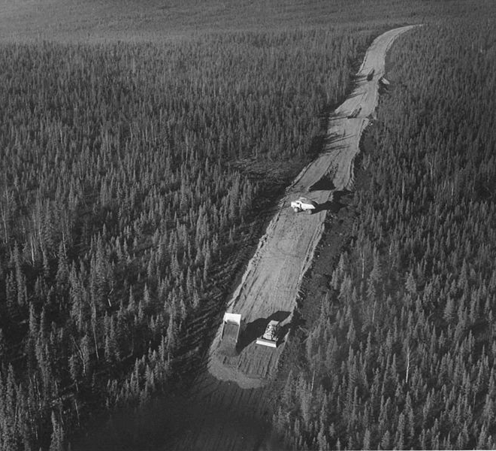
Duty to Maintain and Repair
U.S. Fish and Wildlife Service/ Aerial view of road construction/ Public Domain

Slide 28
Shanak v. City of Waupaca
Shanak sought to make the City of Waupaca pay for repairs to a stone arch and bridge which spanned part of a waterway on Shanak’s land.
Stone arch and bridge were part of a public road under an easement granted to the City to “cross the dam as a highway”
Trial court ruled that because Shanak owned the land the improvements were built upon, Shanak was responsible for the cost of repairs.
Andrew McMillan/Old stone bridge with water flowing gently by the park/ Public Domain

Slide 29
Shanak v. City of Waupaca
Court of Appeals disagreed and held that in the absence of an agreement to the contrary, the dominant estate has a duty to repair the easement.
Because the improvement is a part of the easement, the duty to repair extends to the improvements as well.
Takeaway: When the dominant estate improves an easement, absent an agreement otherwise, they incur a duty to maintain and repair those improvements.
The owner of a servient estate had no duty to repair damage to an easement, so long as that owner is not obstructing the enjoyment of the easement by some affirmative act.
Repairs may be necessary to “prevent the unreasonable interference with the enjoyment of the servient estate, or to avoid liability of the servient-estate owner to third parties.”
Restatement (Third) of Prop.: Servitudes s. 4.13.

Slide 30
Wis. Stat. § 710.20 Maintenance and Repair of Private Roads
(1) Definitions. In this section:
(a) “Access easement” means an easement that is appurtenant to real estate and that provides ingress and egress between the real estate and a public road by means of a private road or driveway.
(b) “Access easement holder” means the owner of real estate that is benefited by an access easement.
(c) “Beneficial user” means a person that has a right to use a private road or driveway. “Beneficial user” includes an owner of real estate burdened by an access easement if the owner has a right to use the private road or driveway.
(d) “Owner” means a person that has a present ownership interest in real estate. “Owner” includes a purchaser of real estate under a land contract that has a right to occupy and use the real estate.
(e) “Private road or driveway” means a private road or driveway located on an access easement.

Slide 31
Wis. Stat. § 710.20
Enacted 12/3/2021
Does not apply to certain utilities or the state or any political subdivision.
Does not apply to damage caused by a particular user
(2) Costs of maintenance and repair. … the beneficial users of a private road or driveway shall contribute to the reasonable and necessary costs of maintenance and repair of the private road or driveway as provided in a written agreement entered into by the beneficial users for that purpose, in the instrument that created the access easement, or in a deed restriction, covenant, or declaration that sets forth the respective maintenance and repair obligations of the beneficial users. In the absence of such a document… the beneficial users shall contribute an equitable share based on the amount and intensity of each beneficial user's actual use in proportion to the amount and intensity of all beneficial users' actual use. In determining whether costs are reasonable and necessary, the beneficial users may consider any of the following factors:
(a) Whether notice of, and an opportunity to participate in, the decision to undertake the maintenance and repair was provided to the beneficial users.
(b) Whether the costs were incurred for work that constituted improvements rather than maintenance or repair.
(c) Whether the work was of a reasonable quality and cost.
(d) The value of monetary or in-kind contributions to maintenance and repair made by beneficial users.

Slide 32
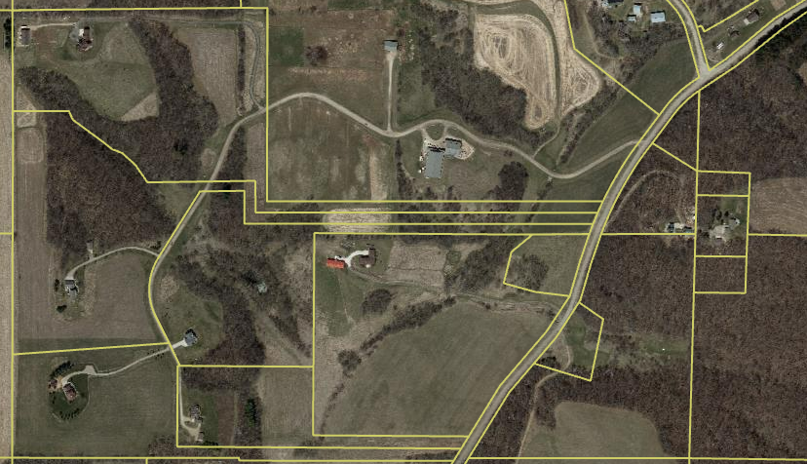

Slide 33
Easement Expiration Under s. 893.33
In general – easements are not enforceable if they are not of record within the prior 40 years (was 60 years)
Record requirement may be satisfied by:
Original recording
Instrument expressly referencing the original easement instrument
Recorded notice of the terms of the easement
Filed, but not recorded survey, does not satisfy the statute.
Only can be asserted by a purchaser (or a successor of the purchaser) if the time period had expired prior to the date of purchase.

Slide 34
Exceptions to 893.33
Conservation easements
Governmental interests
Utility interests
And….
Svetlov Artem/ Russky island path in woods/ CC by 1.0

Slide 35
New Exception for access easements
Does not apply to:
(6m) (b) An easement set forth in a recorded instrument that allows a person to travel across another's land to reach a location or for another specified purpose if any of the following applies:
1. The instrument is recorded on or after January 1, 1960.
2. An instrument is recorded before January 1, 1960, and a notice, the instrument, or an instrument expressly referring to the easement is recorded on or after January 1, 1960, and before the property is sold or transferred.
3. The instrument or instruments expressly referring to the easement were recorded before January 1, 1960, and it is apparent from or can be proved from physical evidence of its use at such time when a person acquired the real estate subject to the easement.
…. What about PRESCRIPTIVE EASEMENTS?

Slide 36
Drafting Considerations
Parties to the easement (servient and dominant estates)
Successors and assigns
Guests, contractors, etc.
Identification of burdened and benefitted parcels.
Access to additional land in the future
What if the land is subdivided
Easement location
Metes and bounds description
“Existing road”
Convenient location
Relocation

Slide 37
Drafting Considerations
Right to improve and duty to maintain
Who can improve?
Scope of required maintenance and allowed improvements
Termination
Perpetual v. termination date
How are costs imposed – allocated, no obligation or fixed duty
Termination if other access is available
Triggered by condition
Purpose of the easement
Ingress and egress v. access
Are utilities included?
Residential v. development v. retail
Are gates allowed?

Slide 38
QUESTIONS?

